Slide 1
Figure 1: Summary statistics of the ADSP WGS cohort
A
B
ε3/ε3: 57%
ε2/ε2: 0%
ε2/ε3: 7%
ε2/ε4: 1%
ε3/ε4: 35%
C
Age
Sex: M F
APOE
ε3/ε3
ε2/ε2
ε2/ε3
ε2/ε4
ε3/ε4
Notes:
Figure 1. Summary statistics of the ADSP whole genome sequencing (WGS) cohort. A. AD diagnosis for 570 individuals across 111 families. B. APOE allele-type composition. C. Age distributions of individuals in each AD status (left). Sex composition in each AD status (middle). APOE allele-type composition in each AD status (right)

Slide 2
Figure 2: Bayes-GLMM estimation of model parameters
A
B
Age -
Cut 1 -
Age
c1
Sex -
Cut 2 -
c2
APOE/e2
APOE/ε2 -
Cut 3 -
c3
APOE/ε4 -
APOE/e4
0
2
4
6
-1
0
1
Effect size
Effect size
Notes:
Figure 2. Bayes-GLMM estimation of model parameters by MCMC sampling of GLMM. (A) posterior distributions of the ordered categorical model’s cut points. (B) posterior distributions of the model covariate’s effect sizes: age, sex, APOE/e2 and APOE/e4.

Slide 3
Figure 3: GWAS of ADSP WGS cohort by Bayes-GLMM
AD status of 570 participants
Covariates: age and sex
Autosomal SNP call by ADSP consortium (27.9 million)
Data
MAF cutoff 0.01 (10.3 million)
IBS kinship relatedness
GLM without random term, flat priors, model inference by MLE
Pre-scan
P-value cutoff 0.0001 (9726)
GLMM with random term, flat priors, model inference by MCMC
Scan
Posterior distribution of variant effects
Notes:
Figure 3. GWAS of ADSP WGS cohort by Bayes-GLMM. Phenotypic trait was the cohort’s AD diagnosis. Age and sex was included as model covariates. 10.3 million genomic variants with MAF > 0.01 were used for kinship computing. 9726 variants with P-values smaller than 0.0001 from the pre-scan were used for the second scan with GLMM.

Slide 4
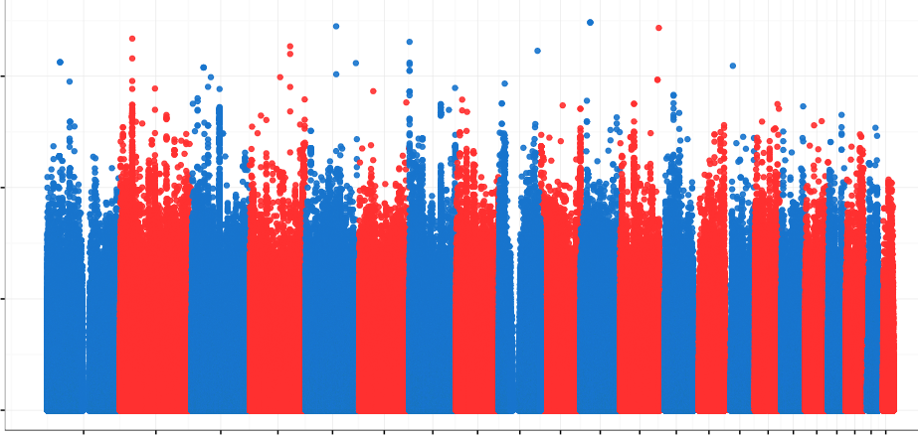
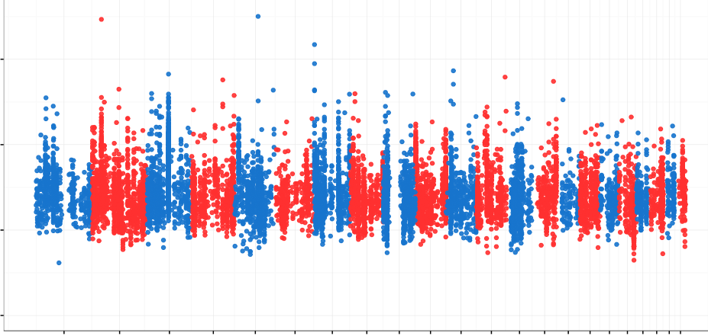
Figure 4: GWAS of ADSP WGS cohort by Bayes-GLMM
A
7.5
5.0
-log10(P)
2.5
0
1 3 5 7 9 11 13 15 17 19 21
B
2 4 6 8 10 12 14 16 18 20 22
Chromosome
rs10490263
rs74944275
rs149372995
7.5
rs140233081
5.0
-log10(P)
2.5
0
1 3 5 7 9 11 13 15 17 19 21
2 4 6 8 10 12 14 16 18 20 22
Chromosome
Notes:
Figure 4. GWAS of ADSP WGS cohort by Bayes-GLMM. (A) GWAS of 10.3 genomic variants by Bayes-GLMM without kinship correction. Model parameters were estimated by MLE. Variants with p-values smaller than 0.0001, above the dash line, were chosen for the next scan (N = 9726). (B) GWAS on filtered variants by GLMM with kinship correction. Model parameters were estimated by MCMC sampling. Dashed line was the cutoff of genome wide significance (5e-8).

Slide 5
Figure 5: Top GWAS variants
rs74944275
rs149372995
rs140233081
rs10490263
Notes:
Figure 3. (a) Top variants with p-values smaller than 1e-6. (b) Functional consequences of the top 244 variants (bar graph?).

Slide 6
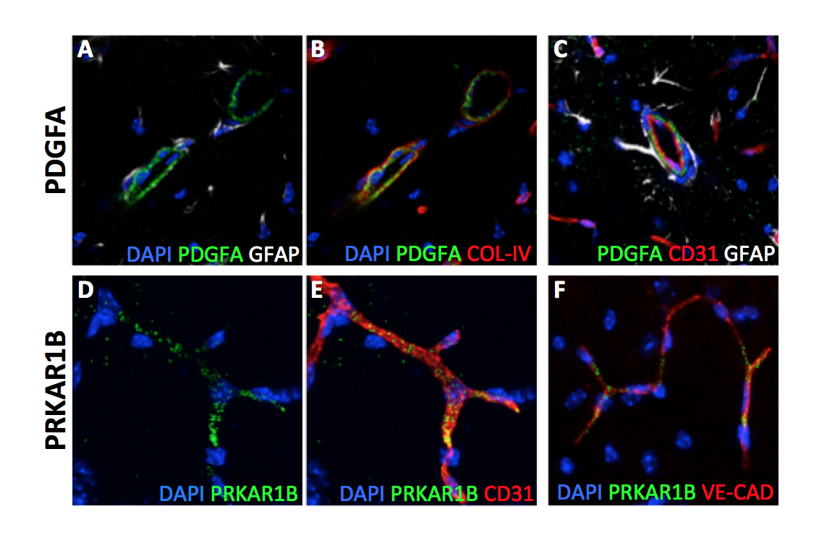
Figure 6: Localization of PRKAR1B and PDGFA.

Slide 7
Figure 7: Effects of priors on model estimations
A
Effect size with
flat prior
Post Effect Size
B
Standard error of effect size with flat prior
Post Standardized Error of Effect Size
C
Post Standardized Effect Size
Standardized effect size with flat prior
D
Post p-value
P-value with flat prior
Prior Standardized Effect Size
Notes:
Figure 6. Effects of priors on the (A) posterior effect size, (B) posterior standardized error of the effect size; (C) posterior standardized effect size; and (D) posterior p-values. X-axis was prior standardized effect size. Grey horizontal line in each graph was the respective posterior estimation when the prior standardized effect size equals 0. The two vertical dashed line defined a range of prior standardized effect size that increased the posterior P-value as compared to a flat prior.

Slide 9
Supplementary Figure 1
Notes:
Supplementary Figure 1. No interaction was detected between each pair of the covariates (age, sex, APOE/e2, APOE/e4).

Slide 10
Supplementary Figure 2
Notes:
Supplementary Figure 2. Genome-wide variants in ADSP WGS cohort stratified by chromosomes. Per chromosome, the red bar represents number of total variants, blue bar represents number of variants that passed the quality check, green bar represents variants that pass the quality check and show MAF larger than 1%.

Slide 11
Supplementary Figure 3: GWAS of ADSP WGS cohort by Bayes-GLMM
A
7.5
5.0
-log10(P)
2.5
0
1 3 5 7 9 11 13 15 17 19 21
B
2 4 6 8 10 12 14 16 18 20 22
Chromosome
7.5
5.0
-log10(P)
2.5
0
1 3 5 7 9 11 13 15 17 19 21
2 4 6 8 10 12 14 16 18 20 22
Chromosome
Notes:
Figure 4. (a) GWAS on 10.3 genomic variants by Bayes-GLMM without kinship correction. Model parameters were estimated by MLE. Variants with p-values smaller than 0.0001, above the grey area, were chosen for the next scan. (b) GWAS on filtered variants. Model parameters were estimated by MCMC sampling. Dashed line was genome wide significance cutoff (5e-8).

